Slide 1
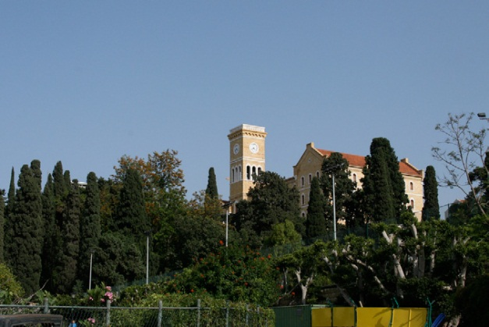
BCBCB Consortium Meeting
March 26-27, 2014, Dubai UAE
Sustainability Education, Research and Engagement Programs
www.aub.edu.lb

Slide 2
Sustainability Education
Sustainability education is indirectly and directly embedded in current undergraduate, graduate, and PhD degree programs in different disciplines:
Landscape Architecture and Ecosystem Management
Rural Community Development
Environmental Health and Public Health
Architecture/Urban Design/Urban Planning
Engineering Programs (Civil, electrical, mechanical and chemical)
ME environmental and water resource engineering
Economics
Political Studies and Public Policy
Interfaculty Graduate Environmental Science Program (ecosystem management, technology, health, and policy)
Applied Energy master Program
Science Programs (biology, chemistry, and physics)

Slide 3
Sustainability Education
Forthcoming programs
Energy Studies (MS): starting fall 2014-15 and is accepting applications
Public Policy and International Affairs (MA): expected to start in the spring of 2014-15
Food security (MA): under development
Complementary and Alternative Medicine (MS ): under development
Professional Training Diploma:
Launching next fall of new professional diploma in green technologies with specialization in energy, water, and buildings.
The diploma will be offered online and face to face through a consortium of universities (AUB, AUC, and LAU)
http://www.progreendiploma.com/

Slide 4
Sustainability Research & Engagement
Role of Centers and Institutes
Research centers of excellence in strategic areas will establish hubs for groundbreaking interdisciplinary research addressing urgent issues for our region and for our times.
Center for Civic Engagement and Community Service (CCECS)
Nature Conservation Center (NCC)
Issam Fares Institute for Public Policy and International Affairs (IFI)
Munib R. and Angela Masri Institute of Energy and Natural Resources (IENR)
Agricultural Research and Education Center (AREC)
Environment and Sustainable Development Unit (ESDU)

Slide 5
Sustainability Research & Engagement
Role of Centers and Institutes
A. The Munib R. and Angela Masri Institute of Energy and National Resources at AUB is playing a vital role in supporting research and development that lead to the sustainable and responsible use, management, and conservation of natural resources and energy. In addition, the institute creates opportunities for top-quality research by funding annually eight or nine research grants by AUB faculty in themes related to energy efficiency, explorations and recovery of oil and gas as well as water and policy research.
http://www.aub.edu.lb/units/masri_institute/Pages/index.aspx

Slide 6
Sustainability Research & Engagement
Role of Centers and Institutes
A. Nature Conservation Center (AUB NCC) is an interfaculty center with a mission to promote the conservation and sustainable utilization of biodiversity in arid and Mediterranean regions by providing an open academic platform for innovative research and development. The NCC wide ranging programs target nature and man’s relationship to nature at all levels and ages of society. NCC investigates the medicinal properties of plants, drawing on traditional and modern understanding. Their program on Food and Health in Rural Lebanon looks at especially vulnerable populations to provide intervention. NCC explains and actively participates in reforestation. The village award program has taught strategies for rehabilitating and greening their public spaces in twenty small towns.
http://www.aub.edu.lb/units/natureconservation/Pages/index.aspx

Slide 7
Sustainability Research & Engagement
Role of Centers and Institutes
A. The Issam Fares Institute for Public Policy and International Affairs (IFI): Examples of two programs
The Climate Change and Environment in the Arab world program was launched in 2008 and aims to use academics technical expertise to answer socially driven questions on climate change and environment in order to fill policy gaps in Lebanon and the Arab World and to influence national and regional debates in International negotiations on climate change and sustainable development through analytical research. New Social Justice in the Arab World Project in collaboration with the Bobst Center for Peace and Justice at Princeton University. The aim of this research initiative is to further understand the many different meanings of the phrase “social justice” and its social and economic policy implications in the following areas: progressive taxation system and economic policy; the right to participate in policy formation; equitable access to health care and education;
reformed safety nets and social security; employment opportunities; restructuring historic relations of the state with elites; civil and citizen rights;
and gender equality.
http://www.aub.edu.lb/ifi/Pages/index.aspx

Slide 8
Sustainability Research & Engagement
Role of Centers and Institutes
The AUB Tobacco Control Research Group (AUB -TCRG) Housed in the Faculty of Health Sciences' Center for Research on Population and Health the project supports the dissemination of information on the local level, the translation of its findings into policy, and the development of a tobacco control regional research network. In 1993 the AUBMC banned smoking, and in 2000 smoking was banned on campus, except in private homes and designated smoking areas. In 2011 AUB campus was chosen as the venue to announce a nationwide ban on smoking in public places.
http://www.aub.edu.lb/units/tcrg/Pages/index.aspx

Slide 9
Sustainability Research Agenda
More than 80 faculty members from all disciplines perform research related to sustainability including the following areas in which AUB has publications.
http://www.aub.edu.lb/units/masri_institute/about/Pages/members.aspx
Energy supply technologies (smart grid, hybrid plants and optimized storage and use systems)
Sustainable water production
Sustainable agriculture
Water treatment
Solid waster management
Green manufacturing and Construction
Energy efficient building systems & processes
Green Transportation
Cooling and innovative water production technologies and systems.
Development of energy and environment policies
Sustainable and low-embodied energy materials and nanotechnology
Energy resource management
human and nature health and wellbeing
Health policy

Slide 10
Sustainability Engagement
Syrian Refugee Crisis Response – sustainable shelter and sanitation solutions by The AUB Center for Civic Engagement and Community Service
The project is focused on improving living spaces for Syrians while taking into consideration Lebanese regulations that prohibit permanent housing for refugees. The unit started by refurbishing a settlement area outside of Sidon last year where over 1000 refugees had been living in dire conditions without any form of waste management. Having successfully implemented this sanitation project with support from Faculty in engineering, the CCECS received $100,000 dollars in funding from a UK-based organization and now runs similar projects across the country.
The CCECS has also teamed up with different departments to devise a shelter called ghata, or “cover” in Arabic, a model of which now stands outside West Hall in AUB. The ghata was designed and constructed by teams from CCECS and the Faculty of Engineering and Architecture and the Faculty of Agriculture and Food Science landscape design program. AUB’s Civil Engineering Society and CCCES erected the first ghata in September in a camp in the south of Lebanon.

Slide 11
Sustainability Engagement
Neighborhood Initiative
Considerable anecdotal evidence exists to fill in this narrative, but theoretically informed, empirical research on the process of gentrification and neighborhood change in Ras Beirut does not yet exist, nor any strategic discussion of what might be done to protect the diversity and character of the neighborhood. During the academic year 2013-2014, the Neighborhood Initiative began an ambitious project to address this lack of research. The newly defined program of research on gentrification will evolve through a collaboration with the Cities Programme of the London School of Economics. In March 2015, the Neighborhood Initiative will partner with the AUB Department of Architecture and Design’s for their annual City Debates. City Debates 2015 will focus on the topic of gentrification and will invite international participation, particular from the region. Research findings on gentrification in Ras Beirut will be featured.

Slide 12
Thank you

