Slide 1
Trauma as Exclusion: Trauma as Inclusion
Prof. Raquel Aldana, School of Law
Marius Koga, MD, MPH, School of Medicine/Public Health Sciences
Thomas O’Donnell, PhD, History
Caroline Perris, JD Candidate, 2022
Alea Skwara, PhD candidate, Psychology, 2021
LatCrit 2021 Biennial Conference

Slide 2
Bridging the Scientific-Legal Divide in the Adjudication of Trauma in Immigration Proceedings

Slide 3
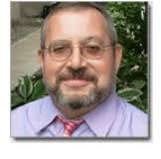
Introducing the Team
Prof. Raquel Aldana,
School of Law, UC Davis
Alea Skwara, PhD candidate,
Psychology, UC Davis
Carmen Velazquez, PhD
Forensic Neuropsychologist
Caroline Perris, JD Candidate,
UC Davis
Marius Koga, MD, MPH,
UCD SOM/PHS
Thomas O’Donnell, PhD, History,
UC Davis DEI
Sharon Howard, PhD,
Forensic Psychologist
Satinder Gill, Psy.D.
UC Davis ASAP

Slide 4
Current Research Objectives
Interrogate
The definition of trauma and its evolution in immigration law as tools of exclusion and inclusion
Compare
Immigration law’s understanding of trauma with the evolution of the term in other disciplines (e.g., psychology, neuroscience, anthropology)
Trace
The evolving role of medical and mental health professionals in the adjudication of trauma in immigration proceedings
Document
The current practice of how immigration forensic assessments are conducted by mental and medical professionals and their different professional expectations with lawyers
Assess
The impact of forensic immigration assessments in shifting outcomes, norms, and practices in immigration law
Identify
The immigration norms, policies and practices that require reform based on a deeper understanding of trauma across disciplines and across cultures
Develop
Culturally responsive assessment measures to conduct forensic immigration evaluations.

Slide 5
Goals from our Research
Short-Term
Long-Term
Promote better interdisciplinary and scientific understanding among lawyers and legal institutions about trauma
Promote better practices in the collaboration among lawyers and mental and health professionals in the immigration adjudication of cases
Institute curriculum reform that includes interdisciplinary approaches to the teaching of trauma in law and medical schools, including the teaching of compassion, coping mechanism for vicarious trauma, etc.
Advocate for legal reform in immigration norms, policies and practices that perpetuate or aggravate trauma (e.g., credibility assessments in immigration proceedings)
Improve the practice of documenting trauma across cultures by medical and mental health professionals working with immigrant communities

Slide 6
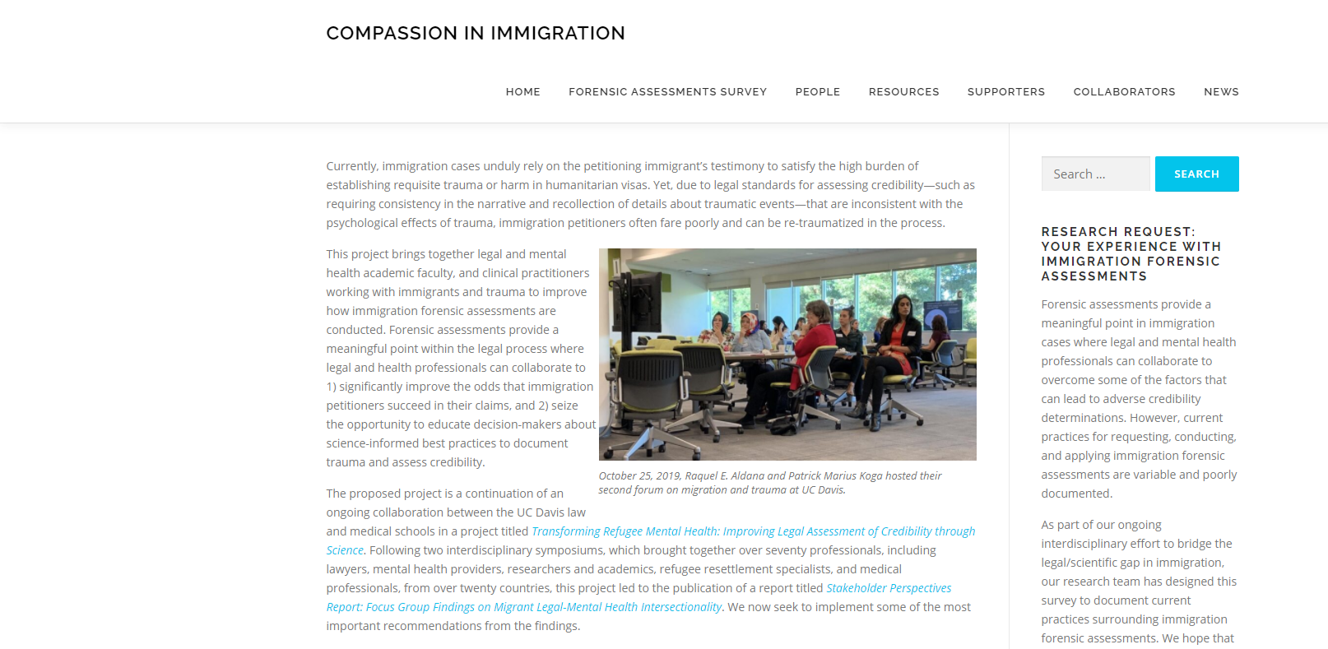
Our Progress to Date https://compassioninimmigration.faculty.ucdavis.edu/
Phase I: 2018-2019
First: Interdisciplinary Convening: Focused Groups
Report: Stakeholders Perspectives Report: Focus Group Findings on Migrant Legal-Mental Health Intersectionality
Second: Interdisciplinary Convening: Main Findings and Next Steps
Phase II: 2020-2022
Survey
Publications
Expanding collaborations

Slide 7
Outline of Our Presentation
Part I: The Western psychological model and the significant gaps between current neuroscientific understanding of the impact of trauma and the role of trauma in immigration law and shortcomings of medicalized definitions of trauma both generally and in the specific case of refugees and asylum seekers (Dr. Koga)
Part II: A. Historical documentation of U.S. federal immigration norms and practices from the late 19th through WWI that facilitated the exclusion or removal of persons with past experiences of trauma. Part B. The evolution of trauma as exclusion in immigration law from WWII to the present and the limited ways in which developments in mental health and progress in racial justice contributed to lessen but certainly not eliminate the biases against immigrants with histories of trauma. (Dr. O’Donnell)
Part III: Developments of trauma as inclusion in immigration law. Part A -- Immigration Law’s Humanitarianism -- Post-WWII’s immigration law’s embrace of grave instances of migrant physical and psychological trauma. Part B. Immigration law’s efforts to ameliorate the trauma of immigration enforcement through judicial developments taming the plenary power + codification of discretionary remedies recognizing immigrant’s liberty “stakes.” (Ms. Perris and Prof. Aldana).
Part IV: When inclusion becomes exclusion: Opportunities and Challenges in Adjudicating Trauma

Slide 8
Contextualizing Trauma
Part I

Slide 9
The What and the Why of trauma
“Epizelos, the son of Cuphagorus, an Athenian soldier, was fighting bravely when he suddenly lost sight of both eyes, though nothing had touched him anywhere — neither sword, spear, nor missile. From that moment he continued blinded as long as he lived. - Herodotus’ description of the Battle of Marathon 490 BC
Herodotus' account of the Athenian spear carrier Epizelos' psychogenic blindness following the Marathon Wars is usually cited as the first documented account of PTSD in historical literature.
Earlier accounts of post combat disorders recorded in Mesopotamia during the Assyrian dynasty (1300-609 BC) explain the disorder in terms of spirit affliction; the spirit of those enemies whom the patient had killed during battle causing the symptoms (Abdul-Hamid, W. & Hacker Hughes, J. 2014).
The treaties of Roman military medicine elaborate on war trauma describing flashbacks, sleep disturbances, low mood, or battle rage. Apian writes about a young soldier, Ulpius Optatus who has unleashed his excessive anger in a hyper-arousal berserker state.

Slide 10
Alternative and conflicting views
Although written accounts of trauma have been transmitted down to us for more than 3,000 years it was only in 1980 that the Western psychology has enshrined its concept of trauma in the DSM III diagnostic category of Post-Traumatic Stress Disorder (PTSD), a cluster of symptoms that plague some survivors of traumatic events, including nightmares, flashbacks, depression, dissociation, and hypervigilance.
PTSD implies a sudden disruption of an individual’s life by a singular, overwhelmingly traumatic event, causing a breakdown of coping mechanisms, producing mental symptoms, and severe functional impairments. This idea been contested by South African and Palestinian critical psychology with the alternative concept of Continuous Traumatic Stress (CTS).
This challenges the assumption of an isolated traumatic disruption and suggests exploring ongoing processes of harm. They allow us to critically engage beyond the dominant individual trauma narratives of war, violence, and sexual assaults, and to consider the structural conditions of social suffering (Kleinman, A., 1997) rather than to focus exclusively on the psychology of traumatic events.

Slide 11
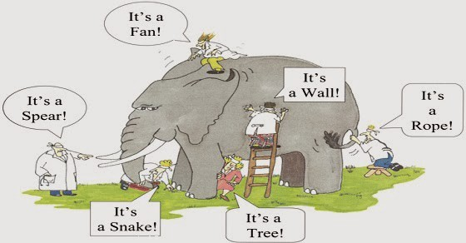
The Multiple Contexts of Trauma
“It is not as important what happens to a person, as to
the meaning that the person gives to what has happened.” – Epictetus – 50-135 CE
The seven blind Indian men

Slide 12
Trauma: a nexus of divergent paradigms
Although the neurobiological processes underlying an acute posttraumatic stress response have universal components, their temporal configurations and interactions are shaped by developmental, social, and cultural contexts. Psychiatric constructs like PTSD have limited explanatory value for non-Westerners. Many asylum seekers do not share Western assumptions about the appropriate ways to assess and respond to suffering and adversity.
Most American research on trauma is shaped by the veteran population and by our dominant modes of interpersonal violence: domestic violence, child abuse, criminal acts, and gang-related violence.
Globally however, the dominant forms of violence tend to be collective: interethnic or interreligious conflict, state sponsored terror, gendered violence, etc. This questions the applicability of individual assessments of traumas that have occurred in non-US social, cultural, and political contexts. A collective trauma requires a collective reconstruction.

Slide 13
Nomen est omen: trauma talking, naming, and labeling
Sometimes, explicit talk about traumatic events may be countertherapeutic when talking about the experience is politically dangerous, when other cultural or spiritual coping strategies compete (such as the Buddhist notion of “letting go” or “nonattachment”, the “flowing water bears no scars” of Morita and Naikan Japanese therapies, etc.) in restoring individual and social equilibrium, or when silence itself wields political power and moral authority.
Clinical and political objections to overmedicalization: applying a PTSD label to victims of political violence and torture may pathologize, disempower and stigmatize the survivors, and delegitimize grievances.
To build bridges between clinical concerns and the social contexts in which experiences and suffering are embedded, we must focus on “what is at stake” in the lives of individuals and communities. This type of cultural analysis provides a common ground on which the shared and disparate concerns of lawyers, ICE, anthropologists, psychiatrists, and psychologists can be addressed and potentially integrated.

Slide 14
The social appropriation of trauma
What is at stake for individuals who have suffered trauma is usually much broader than any discrete psychiatric disorder, encompassing social and political dimensions that articulate with individual experience in complex ways. The accounts of trauma produced within the narrow confines of any one discipline is insufficient.
Although the suffering and impairment caused by a discrete traumatic event may be the primary focus for some individuals, in other cases where the social, moral, and political dimensions of trauma are paramount, and the crucial questions center on how to make sense of violence and loss and how to rebuild one’s life and one’s community in the face of stigmatization, discrimination, genocide, or exile.
It is striking that the individual-centered psychiatric construct of PTSD continues to guide international assessment and treatment programs that are offered to entire communities who have suffered mass trauma.

Slide 15
Stories of trauma: cui prodest? cui bono?
Stories of trauma can be constructed for different purposes: to guide research, assign causality, identify responsibility, apportion blame, to allow individuals to make sense of and get over their suffering, to enable people to live together despite the injuries of the past, or to write a history that informs their identity and warrants the social and moral order. Or to adjudicate an asylum status.
Trauma may become part of the founding myth (Odysseus; Aeneas-Rome) and charter of a people or faction (Karbala/Shia; Mohacs, Kosovo polje, etc.); in such cases, keeping trauma alive becomes important for moral and political legitimacy (e.g. Nakba for Palestinians; Exodus-Titus, Shoah/Holocaust for Israelis).
The story that works for one of these purposes may not have the same efficacy for the others. Consequently, there may be no one story that gets it right from biological, clinical, cultural, and political perspectives.
We must judge each story in terms of the audience to which it is addressed and the goals it aims to achieve. Stories created for one purpose and told in one context go out into the world to be taken up and used for other ends. We cannot ignore these wider implications of the stories we tell about trauma, especially in asylum status determination evaluations.

Slide 16
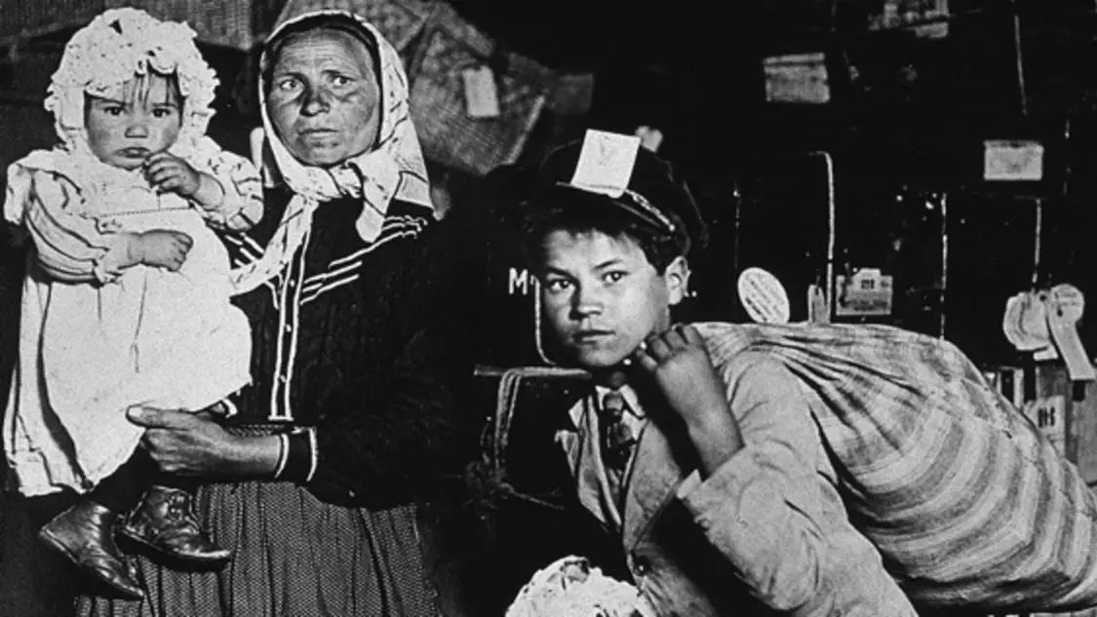
Historical Documentation of U.S. federal Immigration Norms and Practices
Part II

Slide 17
Health Professionals and Immigration Law–A Very Brief and Partial History

Slide 18
Health Professionals and Immigration Law–A Very Brief and Partial History
1891: “All idiots, insane persons, paupers or persons likely to become a public charge”

Slide 19
Health Professionals and Immigration Law–A Very Brief and Partial History
1891: “All idiots, insane persons, paupers or persons likely to become a public charge”
1917: “All idiots, imbeciles, feeble-minded persons, epileptics, insane persons; persons who have had one or more attacks of insanity at any time previously; persons of constitutional psychopathic inferiority; [and] persons with chronic alcoholism.”

Slide 20
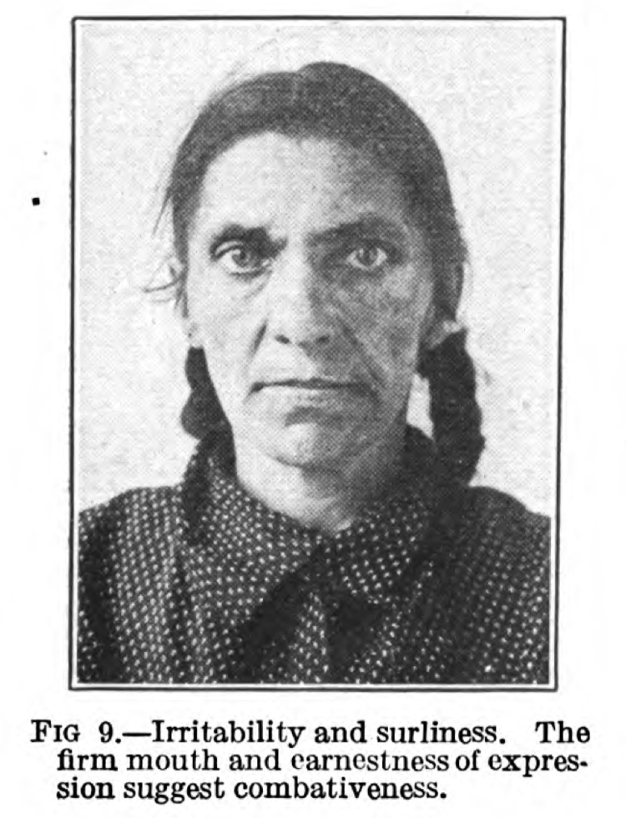
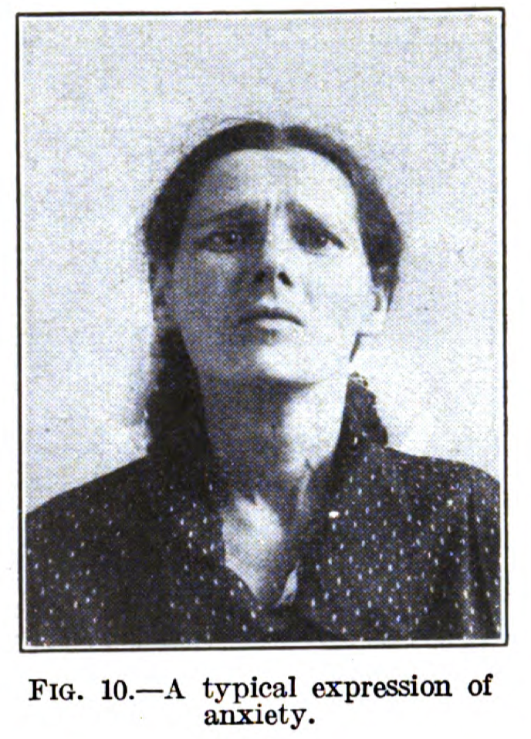
Health Professionals and Immigration Law–A Very Brief and Partial History
The 1918 manual provided portraits of immigrants that claimed to identify disqualifying illnesses from facial expressions.

Slide 21
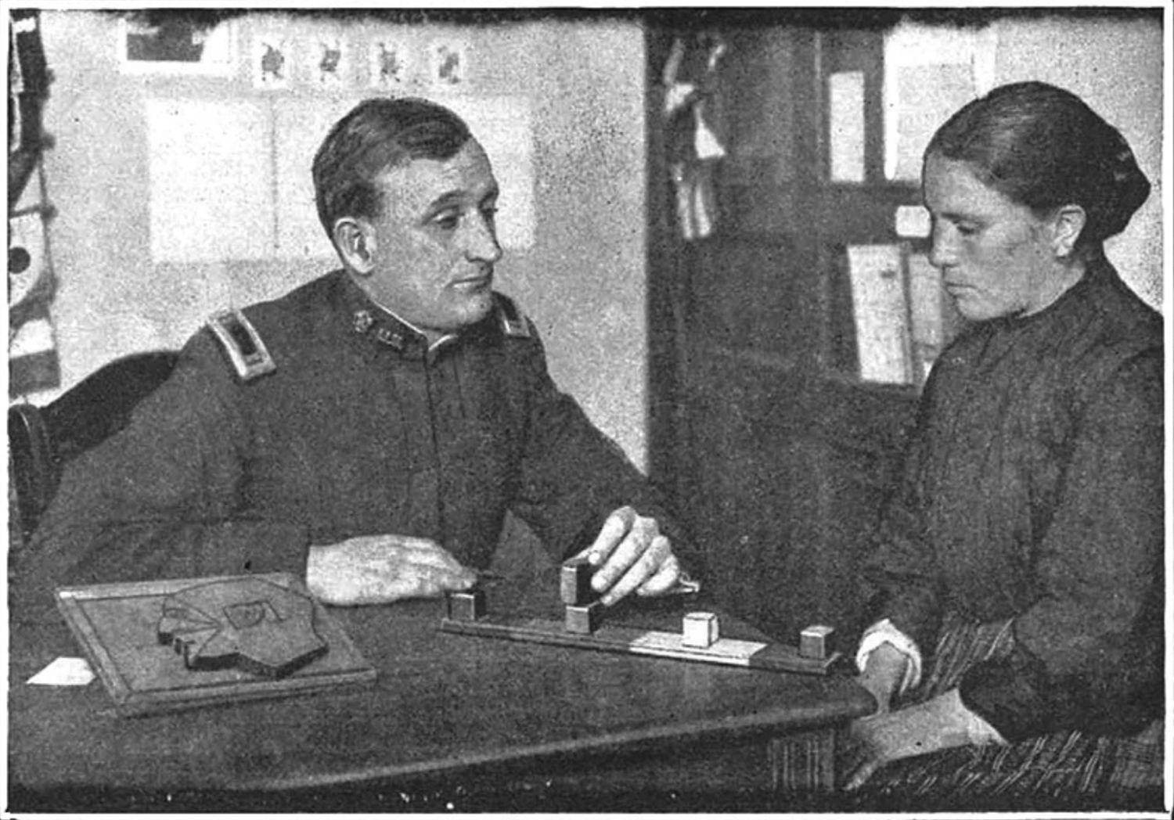
Health Professionals and Immigration Law–A Very Brief and Partial History
An officer of the USPHS administers an intelligence test; the caption from 1915 describes the test subject as “a mentally defective immigrant woman”

Slide 22
Health Professionals and Immigration Law–A Very Brief and Partial History
“Fortunately, the term ‘feeble-mindedness’ is regarded by most alienists as a sort of waste basket for many forms and degrees of weakmindedness, and since it is incorporated in the law as a mandatorily excludable defect, it is especially suited to the needs of [Ellis Island] examiners.”
An officer of the USPHS administers an intelligence test; the caption from 1915 describes the test subject as “a mentally defective immigrant woman”

Slide 23
Developments of trauma as inclusion in Immigration Law Part III

Slide 24
Immigration Law’s Inclusion of Trauma Generally
Immigration Law’s Humanitarianism – the recognition of experiences of trauma as a ground for immigration inclusion
Taming Immigration Trauma – the judicial or political recognition of immigration enforcement’s (exclusion, deportation, detention) as trauma

Slide 25
Timeline of Immigration Law’s Humanitarianism
1948 The Displaced Persons Act
Protected 200,000 Europeans displaced by war
1950 McCarren Act
1966 Cuban Adjust. Act
Withholding of deportation based on physical persecution, amended 1965 and 1996
Favorable treatment of Cuban refugees
Creates asylum protections + amends withholding of deportation
1980 US Refugee Act
1986 Imm. Control Act
1994 Violence against Women Act +
1990 Imm. Act
Amnesty legislation
Battered spouse protections; Temporary Protected Status; Special Immigration Juvenile Status
Self-petitions for victims of domestic violence; waivers for unlawful stays; CAT protections; expanding SIJS protections
1997 NACARA
Special legislation to protect Nicaraguan, Guatemalan, and Honduran asylum seekers
2000 VAWA & TVPRA
Expanded protections for victims of domestic violence; U and T visas for victims of crime and human trafficking (subsequent reauthorization)

Slide 26
The taming of immigration trauma has been a slow process that, if traced, would resemble a complex roller coaster with sharp highs and lows as well as swift reversals.

Slide 27
The Early Asian Exclusion Cases – From Strong Dissents to Meek Majorities
Everyone knows that to be forcibly taken away from home, and family, and friends, and business, and property, and sent across the ocean to a distant land, is punishment; and that oftentimes most severe and cruel.
The punishment is beyond all reason in its severity. It is out of all proportion to the alleged offense. It is cruel and unusual. As to its cruelty, nothing can exceed a forcible deportation from a country of one’s residence, and the breaking of all the relations of friendship, family, and business there contracted. The laborer may be seized at a distance from his home, his family and his business, and taken before the judge for his condemnation, without permission to visit his home, see his family, or complete any unfinished business…
Fong Yue Ting (US 1893) (dissent)
But this court has never held, nor must we now be understood as holding, that administrative officers, when executing the provisions of a statute involving the liberty of persons may disregard the fundamental principles inhere in ‘due process of law’ as understood at the time of the adoption of the Constitution. One of these principles is that no person shall be deprived of his liberty without opportunity, at some time, to be heard, before such officers, in respect of the matters upon which that liberty depends…
Yamataya v. Fisher (US 1903) (Majority)

Slide 28
The Fifth Amendment’s Power over Plenary Power: Territoriality + Stakes
The undocumented*
Non-immigrant
No person shall be …deprived of life, liberty, or property, without due process of law…
U.S. Citizen
LPR
{Parolee}*

Slide 29
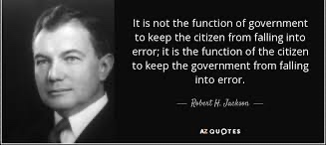
Not Without Notice and a Hearing?
Procedural due process is more elemental and less flexible than substantive due process. It yields less to the time, varies less with conditions, and defer much less to legislative judgment...Procedural fairness and regularity are of indispensable essence of liberty. Severe substantive laws can be endured if they are fairly and impartially applied. Indeed, if put to the choice, one might well prefer to live under Soviet substantive law applied in good faith by our common-law procedures than under our substantive law enforced by Soviet procedural practices

Slide 30
US Supreme Court Slow Evolution of Procedural Fairness: Congressional deference unless “manifestly unfair’ then Balancing test
Yeung How v. North
1911
No right to a “hearing of a judicial character” or to compel witnesses to testify for LPR facing deportation
Landon v. Placensia
1982
Applied Matthews v. Eldridge 3-prong test to determine due process was due in a returning LPR case (slide 14) but ultimately remanded case to decide whether 11 hours of notice was sufficient; what constituted adequate waiver of a lawyer; and who should bear the burden of proof in her case. Government chose not to litigate case on remand.
Marcello v. Bonds
Low v. Backus
1912
No right to challenge government reliance on hearsay evidence from confidential informant for LPR facing deportation. Petitioner must show that process is “manifestly unfair or “so arbitrary” that is robs the immigrant of due process.
1955
Congress can trump the Administrative Procedures Act to establish due process in deportation proceedings and due process was not violated because administrative judges report to the AG who then also persecuted immigration cases and had shown bias

Slide 31
INA Procedural Gains
At the Border
Inside the Border

Slide 32
A Vested Right to Stay and Family? Two Harsh National Security Cases with Cracks
Under our law, the alien in several respects stands on an equal footing with citizens, but in others have never been conceded legal parity with the citizen. Most importantly, to protract this ambiguous status with the country is not his right but is a matter of permission and tolerance. The Government’s power to terminate its hospitality has been asserted and sustained by this Court since the question first arose…Such matters are so exclusively entrusted to the political branches of government as to be largely immune from judicial inquiry or interference.
Harisiades v. Shaughnessy (US 1952) (Dissent)
Today’s disposition should not be interpreted as deciding whether a citizen has a protected liberty interest in the visa application of her alien spouse. The Court need not decide that issue, for this Court’s precedents instruct that, even assuming she has such an interest, the Government satisfied due process when it notified Din’s husband that his visa was denied under the immigration statute’s terrorism bar…Like the professors who sought an audience with Dr. Mandel, Din claims her constitutional rights were burdened by the denial of a visa to a noncitizen, namely her husband…Even assuming Din’s rights were burdened directly by the visa denial, the remaining question is whether the reasons given by the Government satisfy Mandel’s “facially legitimate and bona fide” standard. I conclude that they do.
Kerry v. Din (US 2015) (Plurality, J. Kennedy)

Slide 34
Amnesties and Prosecutorial Discretion

Slide 35
Padilla v. Kentucky (US 2010)
We have long recognized that deportation is a particularly severe “penalty,” but it is not, in a strict sense, a criminal sanction. Although removal proceedings are civil in nature, deportation is nevertheless intimately related to the criminal process. Our law has enmeshed criminal convictions and the penalty of deportation for nearly a century. And, importantly, recent changes in our immigration law have made removal nearly an automatic result for a broad class of noncitizen offenders. Thus, we find it “most difficult” to divorce the penalty from the conviction in the deportation context. Moreover, we are quite confident that noncitizen defendants facing a risk of deportation for a particular offense find it even more difficult.

Slide 36
The Immigration US Supreme Court Cases
Top cases: Post-removal (indefinite detention)
but doctrine of constitutional avoidance applied
to “ambiguous” statute
2001
Zadvydas v. Davis
LPR since age 8 with long criminal record involving drug crimes, attempted robbery, attempted burglary, and theft
Born in a displaced persons camp in Germany to Lithuanian parents (stateless)
Challenging indefinite detention post-removal
Held: “After this 6-month period, once the alien provides good reason to believe there is not likelihood of removal in the reasonable foreseeable future, the government must respond with evidence to rebut the presumption.”
Interpreted: requiring periodic review of detention
2003
Demore v. Kim
LPR since age 6, originally from South Korea, convicted of first-degree burglary and of “pretty theft with priors”
Detained while in removal and contesting legality of mandatory detention under INA § 236(c) and seeking a bond hearing
Held: The Fifth Amendment does not constrain mandatory detention during removal
Interpreted: It did not consider the permissible length of detention if too prolonged and some lower courts have imposed six months
2005
Clark v. Martinez
Non-LPRs in indefinite detention – largely Cubans –all convicted of crimes
The same reasoning/holding in Zadvydas applies
Interpreted: requiring periodic review of detention
2018
Jennings v. Rodriguez
Long-term LPR (30 years) from Mexico
Convicted of a drug offense and theft of a vehicle
Challenging mandatory + prolonged detention during removal – arguing for a 6-month presumption and seeking a bond hearing
Held: The Fifth amendment does not constrain even prolonged mandatory detention during the removal period
Bottom case: During removal
(mandatory detention)
but statute held to be clear

Slide 37
Part IV: When inclusion becomes exclusion: Opportunities and Challenges in Adjudicating Trauma

Slide 38
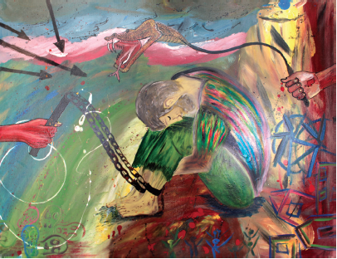
How Do We Document Trauma?
The need to validate claims of past harm
Azraq Camp, Jordan
Notes:
As we move toward understanding trauma as a grounds for inclusion, the need to document or validate claims of past hardship and the impact of trauma has become central to immigration cases. One means by which this is done is through forensic immigration assessments, which are more and more frequently including a mental health component. Our group actually has some survey data on this that I don’t have the time to present to you today (feel free to ask me about it at the end – I do have some slides), but both those data and our group’s conversations with attorneys and evaluators nationwide working in immigration suggest that documenting trauma, and asking for specific mental health diagnoses, are two primary reasons mental health forensic assessments are being sought out.

Slide 39
Documenting Trauma + Mental Health Diagnosis = ???
Notes:
So, when I say documenting trauma, what diagnosis or mental health term pops into your mind? If we were all in a room together, at this point I’d ask you to raise your hand or just shout it out when you think of one. Since we’re in this format I’ll give you a second to think it in your head, or throw it in the chat. Right. PTSD.

Slide 40
PTSD
Posttraumatic Stress Disorder
Notes:
The term PTSD has become almost synonymous with trauma in our shared cultural understanding here in the US. And, at least according to our data, diagnoses like this are playing an important role in immigration cases – while before mental health disturbances stemming from past trauma would have been ground for exclusion, now they are becoming part of the criteria for inclusion. And while the movement toward inclusion is good, and the intention to incorporate more science-informed approaches to criteria is good, And this is problematic for a number of reasons

Slide 41
PTSD in the DSM-5
Exposure to actual or threatened death, serious injury, or sexual violence in one (or more) of the following ways:
Directly experiencing the traumatic event(s).
Witnessing, in person, the event(s) as it occurred to others.
Learning that the traumatic event(s) occurred to a close family member or close friend..
Experiencing repeated or extreme exposure to aversive details of the traumatic event(s) (e.g., first responders collecting human remains; police officers repeatedly exposed to details of child abuse).
Presence of one (or more) of the following intrusion symptoms associated with the traumatic event(s), beginning after the traumatic event(s) occurred:
Persistent avoidance of stimuli associated with the traumatic event(s), beginning after the traumatic event(s) occurred
Negative alterations in cognitions and mood associated with the traumatic event(s), beginning or worsening after the traumatic event(s) occurred
Marked alterations in arousal and reactivity associated with the traumatic event(s), beginning or worsening after the traumatic event(s) occurred
Duration of the disturbance (Criteria B, C, D and E) is more than 1 month.
The disturbance causes clinically significant distress or impairment in social, occupational, or other important areas of functioning.
The disturbance is not attributable to the physiological effects of a substance (e.g., medication, alcohol) or another medical condition.
Notes:
PTSD was added to the DSM-III in 1980 during the aftermath of the Vietnam war to describe a cluster of symptoms that are present in some trauma survivors, Although it’s been updated since then, it is still highly informed by the types of trauma we see most frequently in the US (for example, in veterans of war, victims of gang violence, or survivors of domestic violence or sexual assault). There are a few things I want to point out here in the criteria: 1) the focus on an event or event(s); 2) the criteria for what these events can be is very individualistic and specific

Slide 42
PTSD is a Poor Proxy for Past Harm
Individualistic and event-based conceptualization of trauma
Not well-suited for:
Protracted or ongoing trauma
Structural discrimination or violence
Differences in resilience and susceptibility (e.g., Horn et al., 2016)
Not everyone who experiences trauma will present with PTSD
Some work suggests that resilience is the normative response (e.g., Bonanno, 2004)
Individual differences including gender, developmental history, genetic and epigenetic factors, personality characteristics
Social/structural differences including degree of social support
Cross-cultural differences in how the experience of trauma is understood and expressed (e.g., Kirmayer et al., 2007)
Notes:
So the primary reason that a PTSD diagnosis would be sought in an immigration case is to validate claims of experienced trauma. But PTSD is actually a very poor proxy for past harm. From a scientific perspective, this is true for several reasons. The first has to do with the types of trauma PTSD was designed to capture. As I said, it is those primarily experienced in the US, and as I pointed out on the previous slide, the conceptualization of trauma presented in PTSD is highly individualistic and event-based. So it is actually not well-suited to address or describe experience of protracted or ongoing trauma (such as the refugee experience), or to describe instances of structural discrimination or violence (such as Aparthiad in South Africa), or collective trauma (such as the trauma of being displaced). Secondly, even within the populations for whom the diagnostic criteria are better suited, there are huge individual differences in susceptibility to PTSD resilience. What this means in plain terms is that not everyone who experiences trauma (even severe trauma) will present with PTSD, and some work suggests that resilience may even be the normative response. Some risk factors for PTSD include the type of trauma experienced (very high for sexual violence), which means that a bias towards certain types of trauma is embedded in the diagnosis, and other risk factors relate to individual differences in things such as gender, developmental history, genetics and epigenetics, personality traits. The social environment also contributes heavily to resilience and PTSD vulnerability, so for example having a strong social support system is a major protective factor. Finally, as Dr. Koga mentioned at the beginning, there are huge cross-cultural differences in how trauma is understood and expressed. So while a diagnosis of PTSD for a client who is truly manifesting symptoms of PTSD could support claims and a case-by-case basis, reliance on PTSD diagnosis or symptomology as a proxy for traumatic experience is actually not consistent with scientific understanding, nor cross-culturally reliable

Slide 43
Relying on PTSD diagnoses is necessarily exclusionary
Problems with access and equity
Furthers the narrative of the immigrant as “damaged”
Privileges the symptoms over the experience
Forces asylum seekers and refugees into a Western medical narrative of their experiences—this can be dehumanizing and retraumatizing
Assumes that only those who display symptoms have been through sufficient hardship
Notes:
So on the previous slide, I gave you the scientific reasons why PTSD is a problematic construct, here I’m going to talk about some more humanistic and person-centered reasons. First of all, practically there are problems with equity and access. As you know, even having access to a lawyer is rare for asylum seekers, and there are a number of additional barriers to accessing forensic immigration assessments including access to assessors, money, and time. And if you can’t get an assessment, you don’t have access to a diagnosis. We have heard a number of immigration attorneys express the concern about the implicit precedent this sets up if adjudicators come to expect these reports, and how that might disadvantage asylum seekers who don’t have access to them. Then we have this set of three related issues… And lastly there is the implicit assumption that only those who display symptoms of PTSD have been through sufficient hardship to warrant asylum or have validity to their claims.
So while we see the transition from trauma as a grounds for exclusion to trauma as a cause for compassion and humanitarian action as fundamental to a just immigration system, the pull toward the codification of trauma and trauma symptomology risks perpetuating the exclusionary cycle.

Slide 44
Reframing the Question
How can we use evidence-based psychological and neuroscientific perspectives on trauma to inform criteria for inclusion?
How can we use psychological/neuroscientific perspectives to make the asylum seeking process more trauma informed, and afford asylum seekers the opportunity to best make their case
Focus on making the process more inclusive, accessible, and trauma-informed
Notes:
So if not through application of clinical criteria say, for PTSD, how is it that our current understanding of psychology and neuroscience might be able to contribute to a more just immigration system? Well I would say that it starts with reframing the question. So instead of asking… I would ask…
So rather than relying on some specific criteria, we can shift the focus to making process more inclusive, accessible, and trauma-informed

Slide 45
Trauma and Memory
“My Grandmother” by Mohammed Al-Amari
Cabeza & St Jacques, 2007
Notes:
So what might that look like? There are many ways this dialogue can be fruitful. One immediately obvious way is in integrating what we know from scientific studies of stress, trauma, and memory to build understanding about what a credible narrative might look like in instances of trauma.
In order to tell the story of their experience, asylum seekers must access their autobiographical memory. In short, autobiographical memory is the memory for our own life events, and requires the joint activity of multiple interacting brain systems including
Hippocampus (involved in encoding and recollection of the memory)
Amygdala (involved in emotion processing)
Prefrontal Cortex (PFC; self regulation, representation of self, search of memories, etc.)

Slide 46
High Levels of Stress Affect the Brain Systems Required for Autobiographical Memory
Arnsten et al., 2015
Notes:
In instances of uncontrollable stress, we see a number of neurochemical processes in the brain, which can ultimately serve to weaken prefrontal areas and strengthen the influence of the amygdala.
The amygdala drives arousal systems, increasing the firing of neurons in the midbrain (locus coeruleus). This can increase the release of a class of neurotransmitters called catecholamines. At moderate levels, these enhance the activity of regions of the PFC, and weaken the influence of the amygdala. Under acute, uncontrollable stress, high levels of catecholemines weaken prefrontal areas and strengthen the influence of the amygdala.

Slide 47
In Summary:
Autobiographical memory requires the joint activity of multiple interacting brain systems
Hippocampus
Amygdala
Prefrontal Cortex (PFC)
Chronic stress affects the structure and function all of these key brain regions
This can lead to disruptions in autobiographical memory, making the task of recalling past events in one’s life particularly difficult
A longer presentation I gave on this topic (with notes!) is available on our group’s website or can be sent to you
Notes:
This is just one small example of

Slide 48
A Few Places to Start…
Forensic assessments as educational rather than diagnostic tool
What, for this individual, might “credibility” look like?
Culturally-appropriate and informed assessors and interviews
Still issues around access and equity
Trauma-informed interview process and court proceedings
Work to bridge the legal/scientific gap: find leverage points where conversation between law and science can be generative (e.g., trauma and memory)
“Exile from One’s Country” by Mohammed Al-Amari

Slide 50
References
Arnsten, A. F., Raskind, M. A., Taylor, F. B., & Connor, D. F. (2015). The effects of stress exposure on prefrontal cortex: Translating basic research into successful treatments for post-traumatic stress disorder. Neurobiology of Stress, 1, 89-99.
Bonanno, G. A. (2004). Loss, trauma, and human resilience: have we underestimated the human capacity to thrive after extremely aversive events?. American Psychologist, 59(1), 20.
Cabeza, R., & St Jacques, P. (2007). Functional neuroimaging of autobiographical memory. Trends in Cognitive Sciences, 11(5), 219-227.
Horn, S. R., Charney, D. S., & Feder, A. (2016). Understanding resilience: New approaches for preventing and treating PTSD. Experimental Neurology, 284, 119-132.
Kirmayer, L. J., Lemelson, R., & Barad, M. (Eds.). (2007). Understanding Trauma: Integrating Biological, Clinical, and Cultural Perspectives. Cambridge University Press.

Slide 51
Survey
Goal: Document current practices in forensic assessments for immigration cases
Is there a perceived legal/scientific gap among practitioners?
What is being done well? What is in need of reform?
Interested in both practices AND perceptions
Scope: Focus on assessments of credibility and psychological forensic assessments
Future plans to construct survey to target physical/medical forensic assessments
Participants: US-based Legal and mental health professionals who use or conduct forensic assessments in immigration cases
Focus on the 11 states and districts with the highest share of immigrant populations/immigration cases
Method: Mix of multiple choice, likert scale, and free response questions
Responses: N = 96 attorneys, N = 52 mental health forensic evaluators

Slide 52
Factors cited as the reason for seeking immigration forensic assessment
Attorneys
Mental Health Evaluators

Slide 53
How often are mental health diagnoses sought
Attorneys
Mental Health Evaluators

Slide 54
What are attorneys asking to have assessed as part of a forensic evaluation?
Attorneys
Evaluators

Slide 55
What role do mental health diagnoses play?
Attorneys
Mental Health Professionals

